Slide 1
How to…. Cancel a referral request / UBRN
Select the patient tab to allow a search using the UBRN

Slide 2
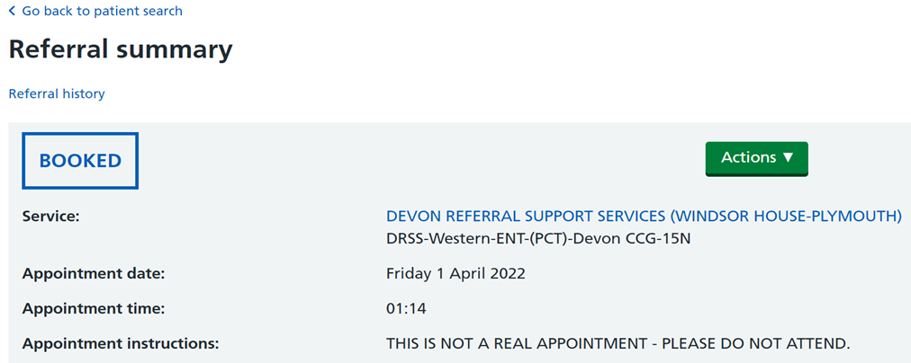
How to…. Cancel a referral request / UBRN - continued
On the Referral summary page, select the dropdown from the green ‘Actions’ box

Slide 3
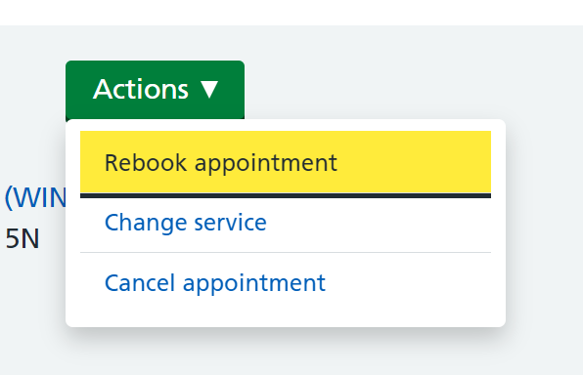
How to…. Cancel a referral request / UBRN - continued
Three options will be shown.
Select ‘Cancel appointment’

Slide 4
How to…. Cancel a referral request / UBRN - continued
Select the reason for cancellation from the dropdown list and add comments in the ‘Reason for Cancellation Comments’ box
Note: some cancellation reasons will cancel the UBRN request (i.e.‘Patient intends to go private’, referral no longer required, and Referral raised in error’). All other reasons will allow you to rebook using this UBRN.
All un-booked UBRNs will need to be actioned

Slide 5
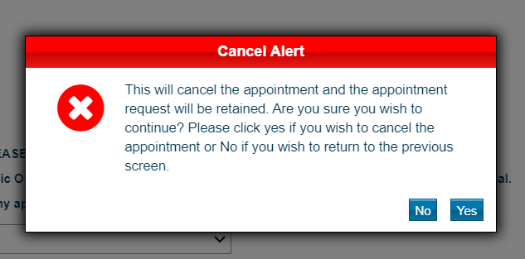
How to…. Cancel a referral request / UBRN - continued
The Cancel Alert is to confirm you wish to cancel the appointment and the request (UBRN).
Click ‘Yes’

Slide 6
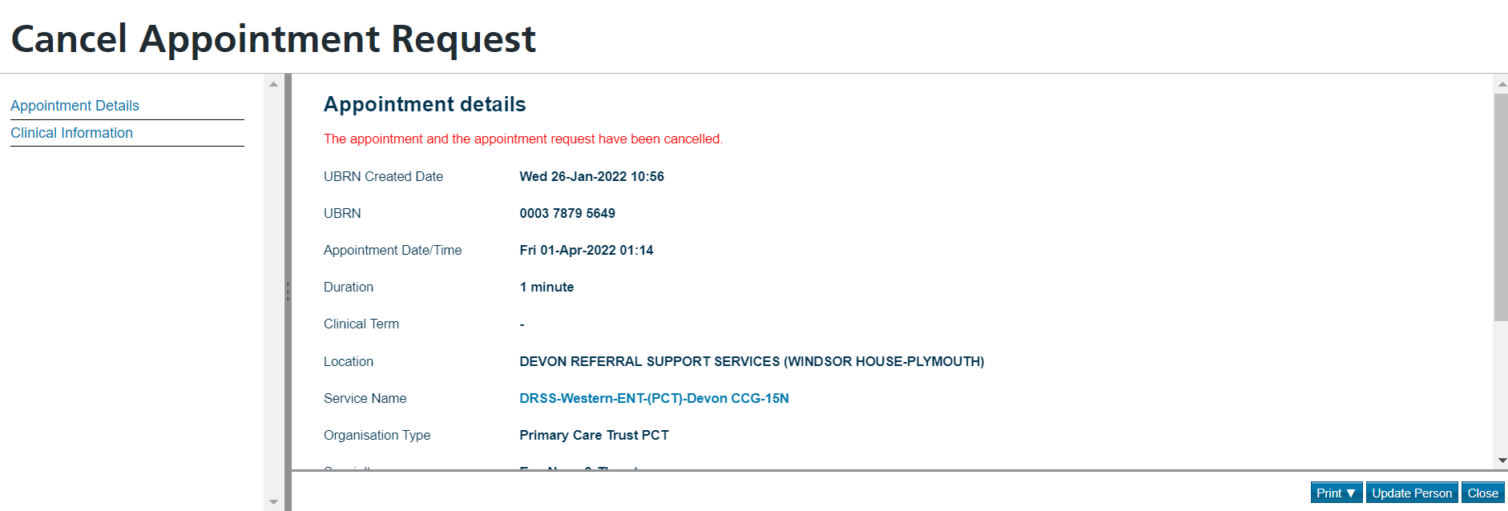
How to…. Cancel a referral request / UBRN - continued
Click ‘Close’ on Cancel confirmation page to end task.

