Slide 1
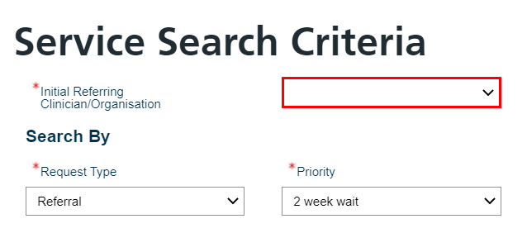
Urgent Suspected Cancer referrals on e-RS – How to… Refer & Check the Status
REMINDER: Please use the appropriate Urgent Suspected Cancer referral template – these can be found on the Formulary and Referral website
How to…. Refer
Ensure Priority is 2 Week Wait
Select 2WW in the Specialty dropdown
Select appropriate 2WW option in the Clinic Type dropdown
Click on the Search Primary Care button

Slide 2
How to…. Refer cont.
A list of services will appear
You will now have 2 options
If the 2WW service is a Referral Assessment Service, select and the Hospital will now be in contact with the patient to discuss the date and time of the appointment.
If it is an appointment service, select the service and select wait a few seconds for the appointment to book then click Close.
NB. If there are no appointments showing, please click
The UBRN is complete
Ensure the Urgent Suspected Cancer referral template is attached to NHS e-Referral on the same day
If the referral is left un-booked or no letter attached the team will chase this up after 24Hrs.

Slide 3
How to…. Check the Status
Practices are recommended to do this on a daily basis
Click on the Enquires tab
Select Two Week Wait Enquiry from the dropdown list and select Search
A list will appear. This will show all your:
Booked 2ww referrals
Cancelled 2ww referrals
If the reason is ‘Patient booked outside NHS e-Referral Service’ this means that the Provider has experienced slot availability or technical issues when trying to book the patient an appointment and has therefore booked the referral outside of NHS e-Referral Service. You can search for these in the patient tab and select
Deferred to Provider referrals (used when no appointments available at booking stage) Provider will contact patient to book.

