Slide 1
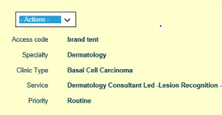
How to…. Track a referral on e-RS – step by step
You can track a referral on e-RS by clicking on the UBRN number – a box will appear:
Select Actions and View History you can see what has happened so far with the UBRN.
You can click on each action shown on the left side of the screen, this will show you who and when your patients e-RS referral has been accessed and any actions/comments they have made.

Slide 2
How to know when a patient has been ‘deferred to provider’ & what this means
Once in the patients record, click on the relevant UBRN. This should bring you to the referral summary page.
This page shows what provider the patient has been booked into. It will also show if they have an appointment or if they have been added to a waiting list.
This example states ‘cancelled referral’ as the patient is no longer being managed on e-RS and is now with the chosen provider waiting an appointment date.
The patient will now be booked onto the hospital system directly, in this case – IPM, Derriford’s Hospitals system.

