Slide 1
How to…. Request Advice & Guidance – step by step
Please see links below for the available Advice and Guidance (A&G) services on e-Referrals.
Torbay & South Devon NHS Foundation Trust
Royal Devon & Exeter NHS Foundation Trust
Northern Devon Healthcare NHS Trust
University Hospital Plymouth NHS Trust
Select patient in NHS e-Referral system or from your GP clinical system in the usual way, Select Refer/Advice

Slide 2
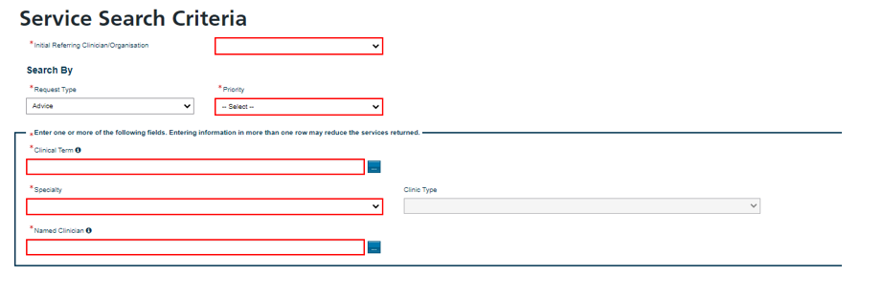
How to…. Request Advice & Guidance – step by step cont..
Complete Service Search Criteria screen. Select Advice for the Request Type. Select appropriate Specialty and Clinic Type. Select Search Primary Care.
Select the service at the Trust you would like to obtain the Advice and Guidance from. Select Request

Slide 3
How to…. Request Advice & Guidance – step by step cont..
Complete Advice Request Details, adding any attachments if relevant.
Select if you authorise the provider to convert the referral if appropriate.
Select Send Request - this will allow selection once all mandatory fields completed.

Slide 4
How to…. Request Advice & Guidance – step by step cont..
You can find all advice and guidance responses in the advice and guidance box within your worklists

