Slide 1
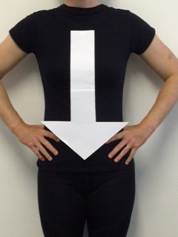
Bladder Control Problems or Pelvic Floor Weakness?
Specialist NHS Physiotherapy can help – and now you can refer yourself!
No leak is normal – even a little one!
If you are female and over 16 we can help with the following:
Bladder leaks – Prolapse
Bladder urgency & frequency
Pelvic floor weakness
Refer yourself and take control!
Call us on: 0300 0040335

